Slide 1

Pokémon Classification
Group 8:
Russell, Matthew
Marinas, Vincent
Qiunan Zhao

Slide 2

Overview
Project Background
EDA
Data Preprocessing
Model
Image Prediction
Future Recommendation

Slide 3


Project Background
All Pokemon from generation 1 to generation 7 with data of images and types(primary and secondary)
Try and successfully predict Pokemon primary types based on appearance.
Notes:
Data preparation
Importing the datasets
Mapping the primary types (labels)
Segregating data into images and labels (train and test sets)
EDA
Counts of each Primary type, Secondary type, etc.
Modeling
Build the MLP structure
Validation
Calculate prediction accuracy with test set

Slide 4
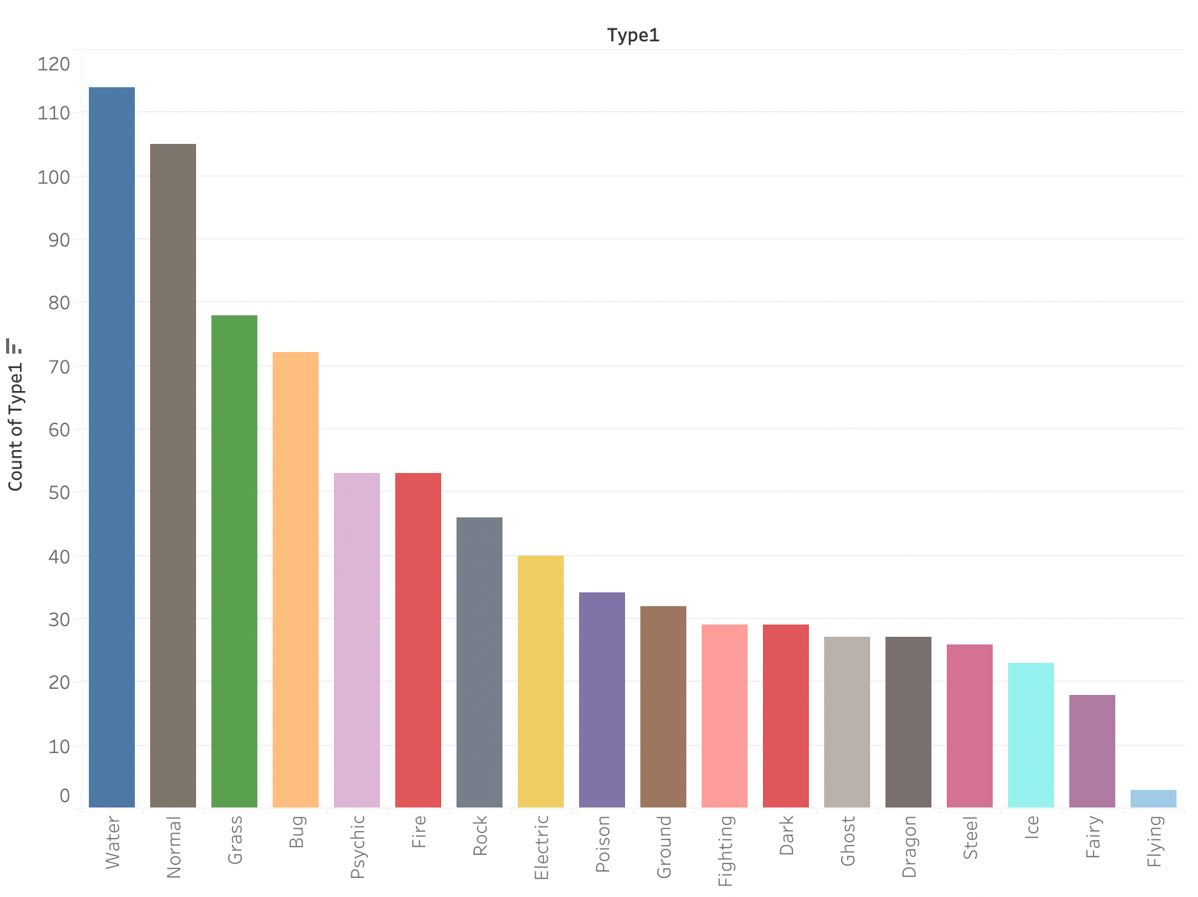
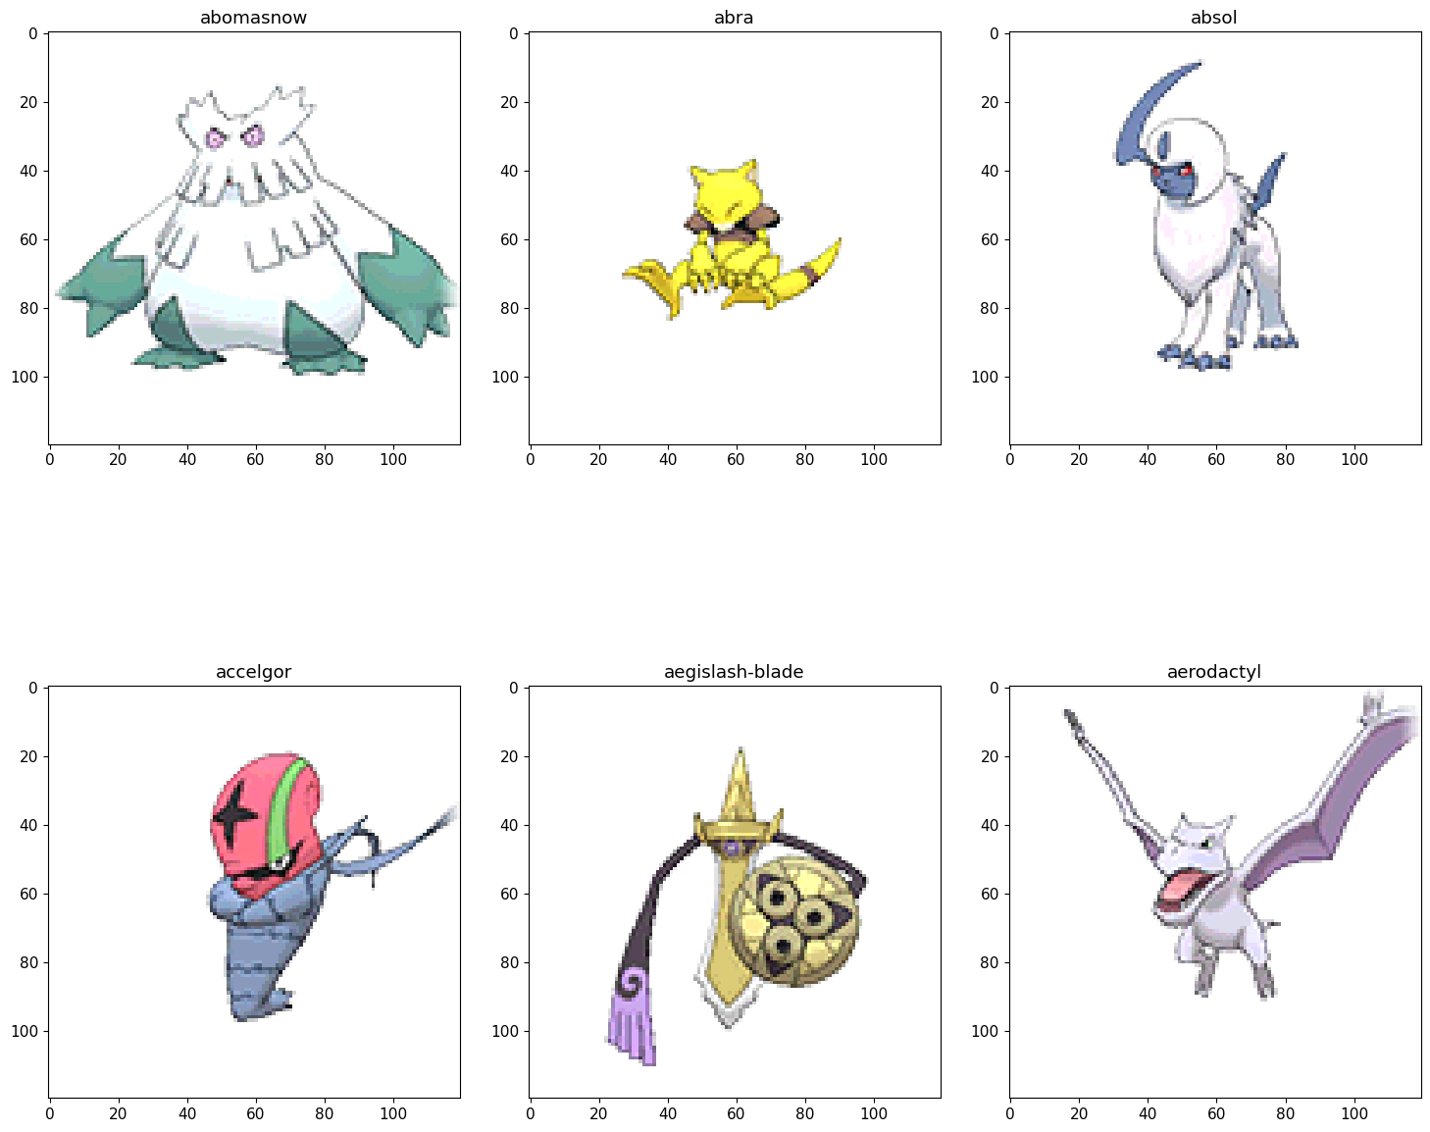
EDA
Of the 809 Pokemon:
Water Type: 114
Normal Type: 105
Flying Type: 3
8 types with less than 30 pokemon

Slide 5
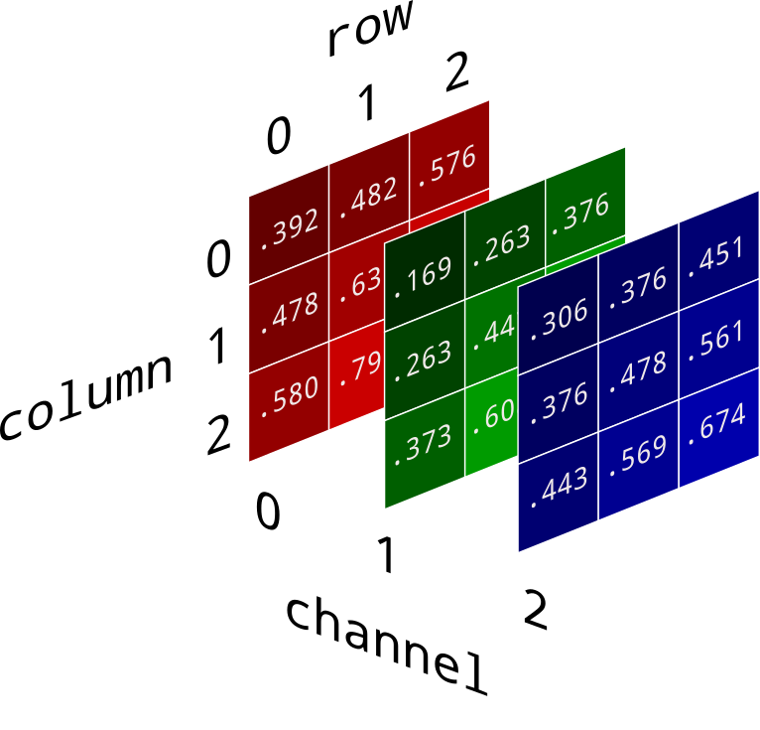

Data Preprocessing
Read images as 3D arrays using cv2 package
Split image arrays and labels into training and testing sets

Slide 6
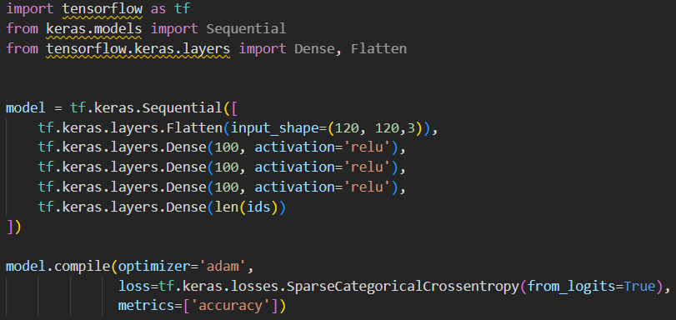
Model
MLP Structure
Input layer of shape:
120 x 120 x 3
3 hidden layers
Output layer equal to the number of types

Slide 7
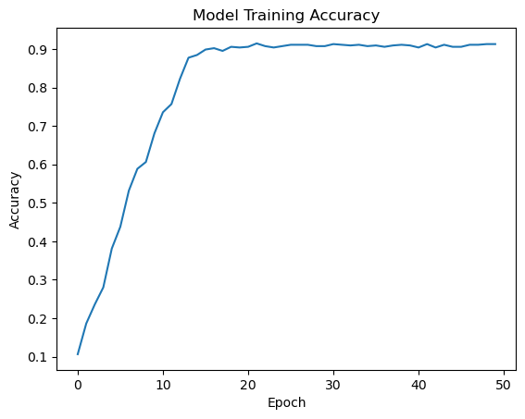
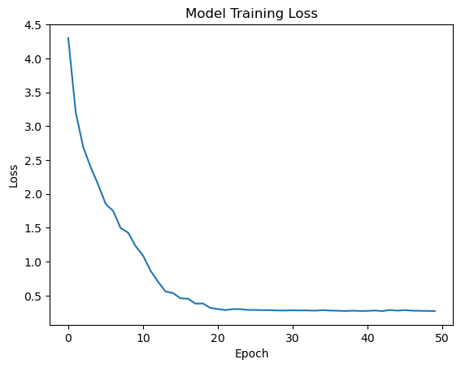
Model Evaluation
17 Pokemon Type Labels
564 training images
242 test images
15% test accuracy
Random Guess: 5.9%

Slide 8
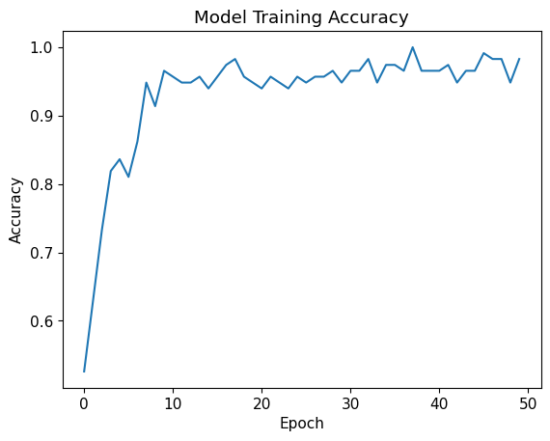
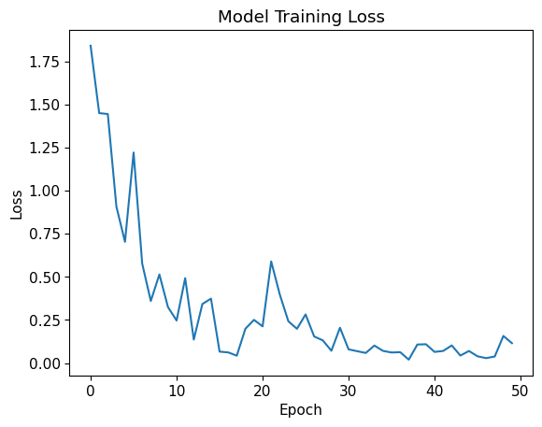
Model Evaluation, Fire vs Water
2 Pokemon Type Labels
153 training images
66 test images
88% test accuracy

Slide 9
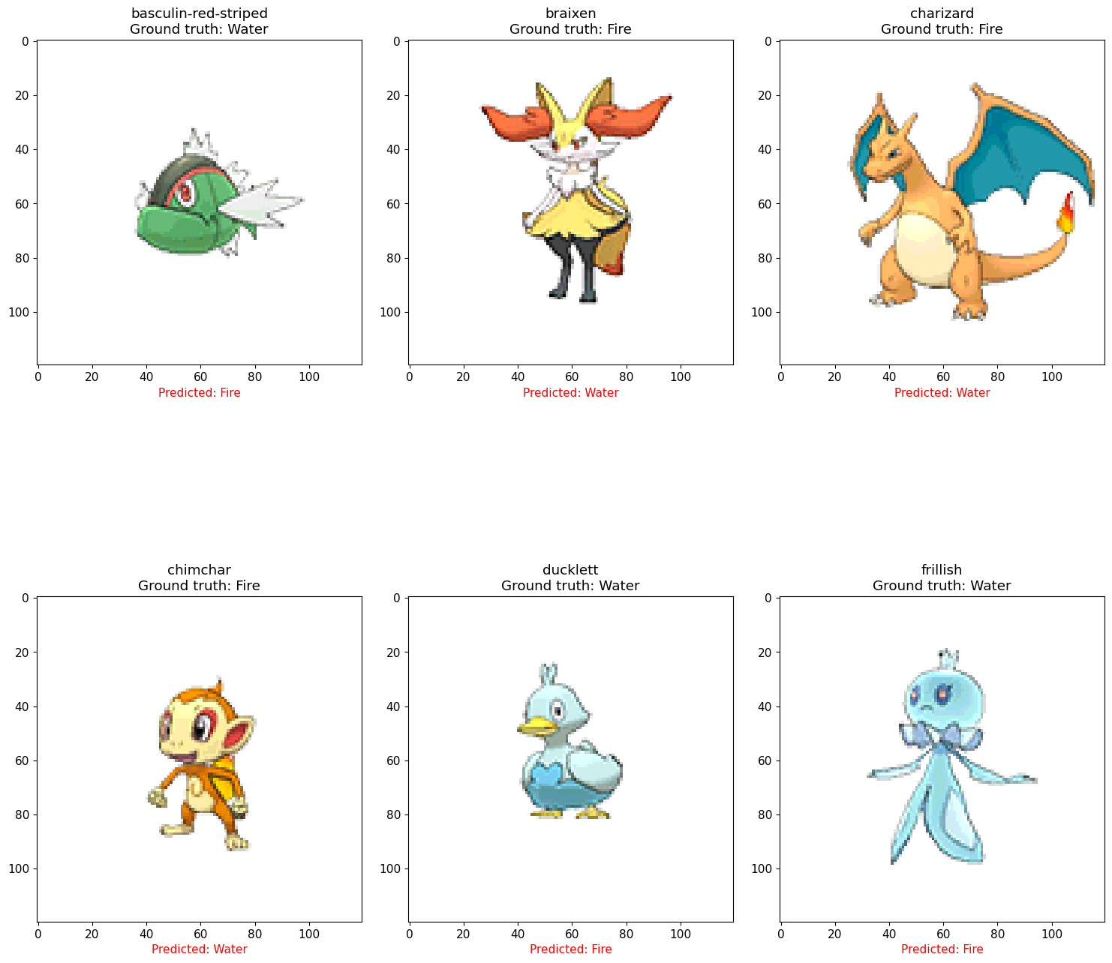
Predictions, Fire vs. Water
88% Accuracy

Slide 10
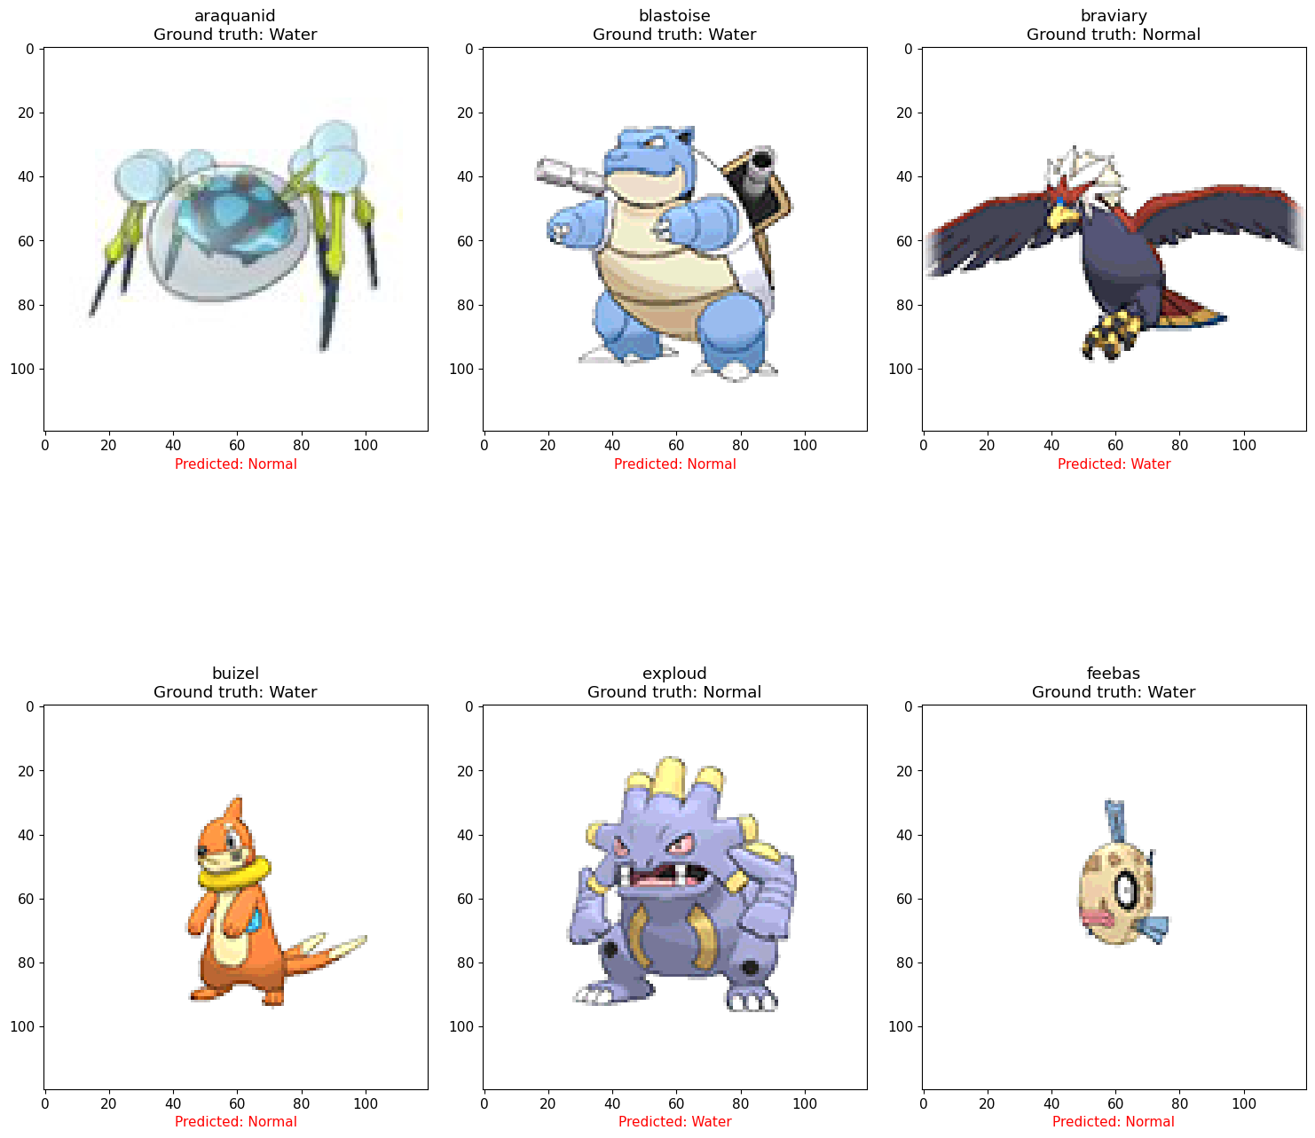
Predictions, Water vs. Normal
64% Accuracy

Slide 11

Next Steps
Try other modeling techniques.
Obtain alternate images of pokemon
Data Augmentation:
Rotation
Zoom
Brightness
Contrast
Collect data on Pokemon Statistics & try predictions
Notes:
Pokemon Stats:
Health points
Attack
Defense
Speed

Slide 12


Q&A

Slide 13
Problem Analysis
Alternatives vs. chosen model structure
Issues with the scope
Class Imbalance
Variability within each class
Limited number of images
Notes:
Alternative model: binary logistic regression with L2 penalty

Slide 14
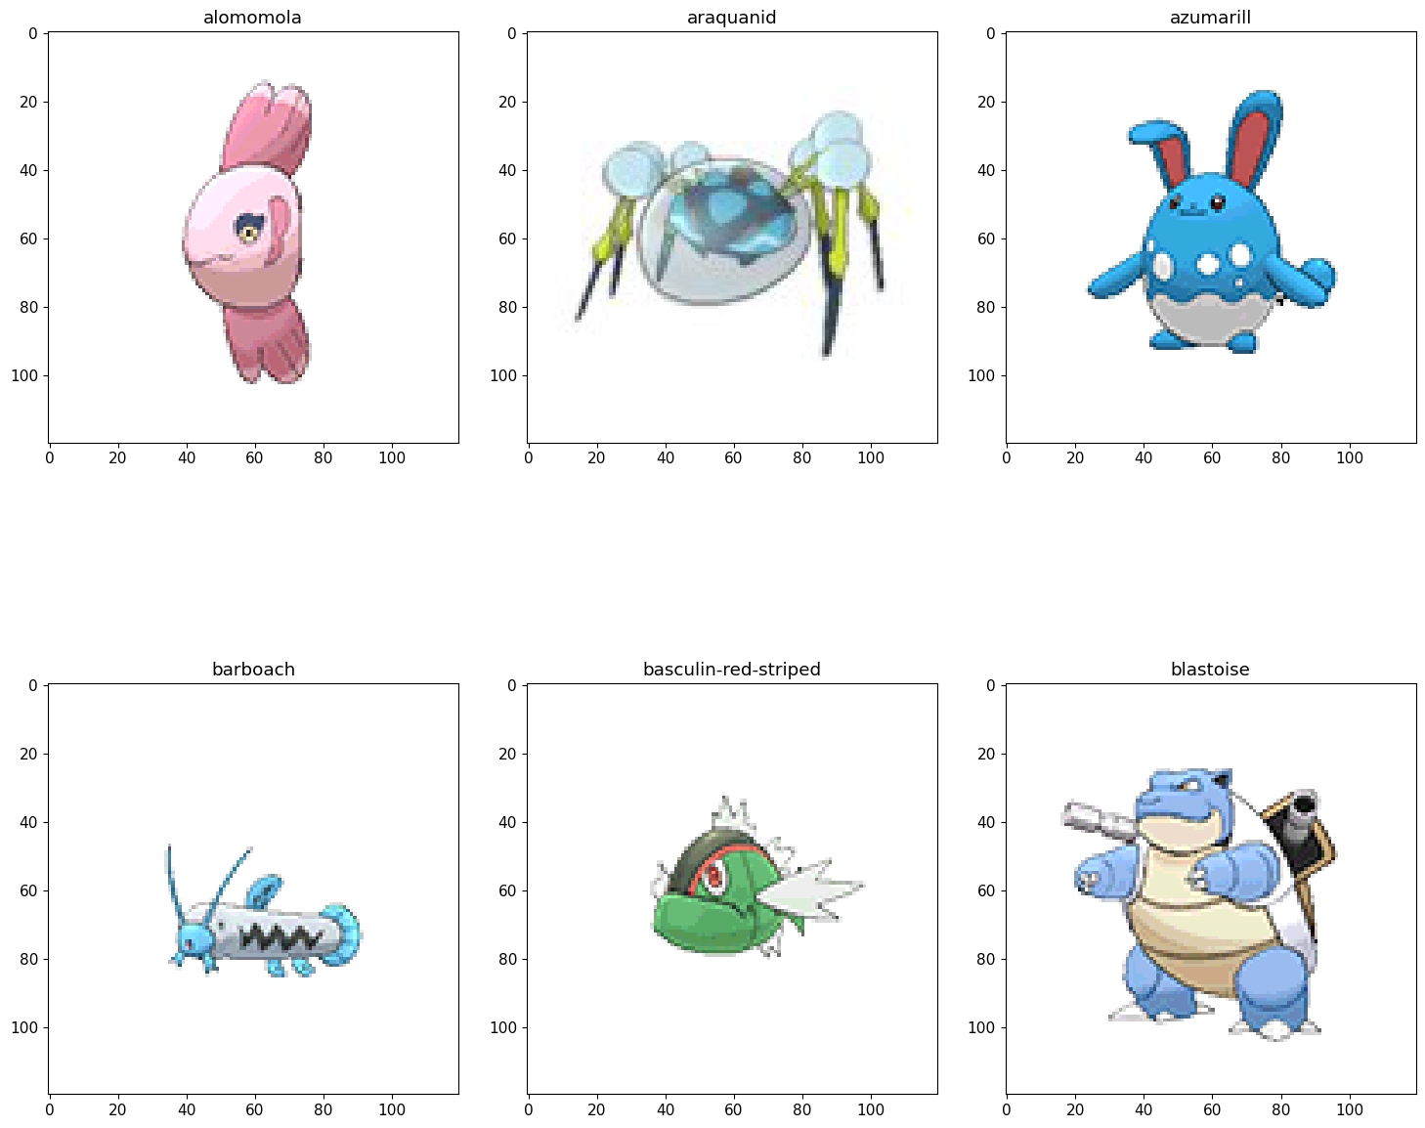
Variability within a single type

Slide 15
